Slide 1
ENERGY OPTIMIZATION FOR WIRELESS SENSOR NETWORKS
MAJOR PROJECT ( SEMESTER-8 )
Project Guide - Dr. Suneel Yadav
SAKSHAM ROHILLA
IEC2019040

Slide 2

INTRODUCTION
Internet of Things (IoT) has sensor nodes (SNs) in its primitive
layer for collecting data from an area of interest.
These SNs are powered by a battery which is a significant
constraint due to its limited capacity.
Wireless Sensor Network (WSN) is an assemblage of small
embedded devices, which are called sensors that are capable
of communicating wirelessly

Slide 3
INTRODUCTION
The network’s lifetime is required to be prolonged to serve the objective of deploying the SNs.
One major challenge which persists is the limited battery power constraint which calls for innovative solutions in terms of developing an optimal communication and routing technique.
Various mathematical algorithms and optimisation models are applied to the network to achieve high performance.
These models are LEACH,Grey Wolf Optimization (GWO) and further additions to Leach.

Slide 4
LITERATURE SURVEY
Naveen Chawla and Ashish Jasuja. “First Node Die (FND) Time Enhancement in LEACH Protocol” International Journal of Science and Research (IJSR)(2012)
Mehra, Pawan Singh. "LBECR: load balanced, efficient clustering and routing protocol for sustainable internet of things in smart cities." Journal of Ambient Intelligence and Humanized Computing (2022): 1- 23.
Jaiswal, Kavita, and Veena Anand. "A Grey-Wolf based Optimized Clustering approach to improve QoS in wireless sensor networks for IoT applications." Peer-to-Peer Networking and Applications 14.4 (2021)
Hong, Jiman, et al. "T-LEACH: The method of threshold-based cluster head replacement for wireless sensor networks." Information Systems Frontiers 11.5 (2009): 513-521.

Slide 5
AIM
Energy Optimization for Wireless Sensor Networks(WSN) in IoT.
To improve pre-existing models to reduce energy consumption in wireless sensor networks and prolong the lifetime of these WSNs with major focus on First Node Dead(FND).

Slide 6

METHODOLOGY
Simulation Parameter | Value
Number of nodes (N) | 100
Grid Size | 100x100
Location of Base Station | (50,50)
Initial energy of nodes | 1J
Data Packet Size (t) | 4000 bits
Cluster head percentage selection (p) | 10%
Surrounding radius for cluster head(Rc) | 25 units
Random distribution of nodes in grid
Need to implement algorithm such that we get maximum rounds of communication before any of the 100 nodes dies(energy left=0).

Slide 7
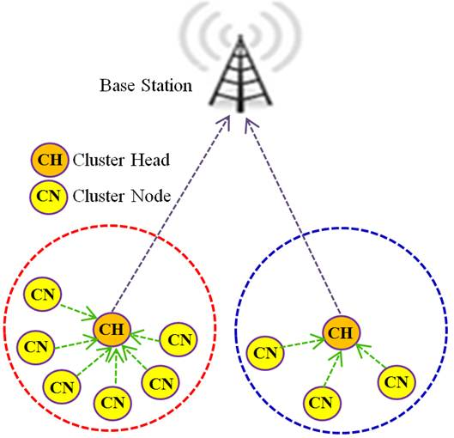
CLUSTERS
All nearby nodes act as one cluster with the node
with maximum energy becomes cluster head.
Cluster head communicates with Base Station.
Cluster head is not fixed but keeps changing depending
on many parameters such as intra cluster distance,
total number of alive nodes,energy level of nodes.

Slide 8
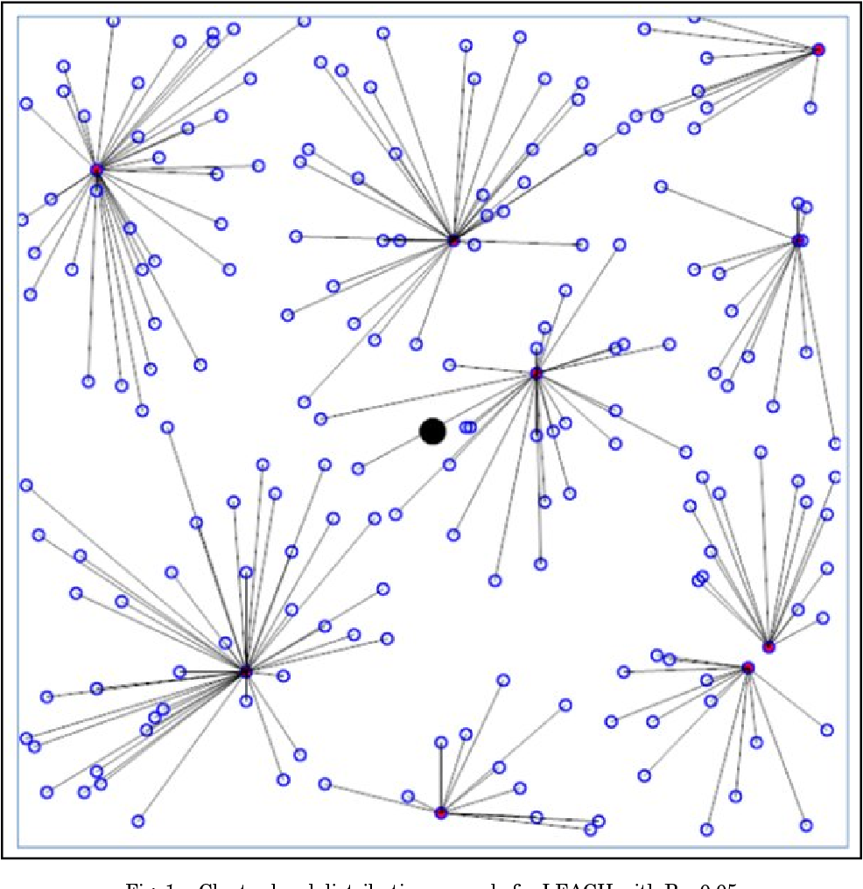
METHODOLOGY
Choose number of cluster heads(p=10%)
Choose surrounding radius for cluster head(Rc=25)
Calculate energy level, fitness, total dead and alive
nodes, node with maximum energy.
Make a node the cluster head.
For that cluster head make its clusters, choosing how
many cluster member it should have.
Optimize energy using node distance to cluster head,
base station and fuzzy logic.

Slide 9
CLUSTER HEAD SELECTION
Cluster head is selected depending not only on the energy level but using fitness function having 5 parameters.
Residual energy
Node degree
Average intra cluster distance
Distance from base station
Balancing factor
The fitness function returns output as w1*f1 + w2*f2 + w3*f3 + w4*f4 + w5*f5.

Slide 10
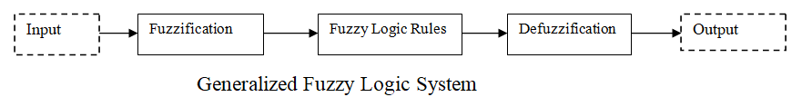
CLUSTER FORMATION – FUZZY LOGIC
Nodes choose a cluster head from list of all the cluster heads using Fuzzy Logic.
Fuzzy logic takes 2 inputs-fitness & distance of node to cluster head.
Distance to cluster head | Fitness | Feasibility
Less | Weak | Decent
Less | Decent | Powerful
Less | Strong | Massive Powerful
Moderate | Weak | Decent Low
Moderate | Decent | Decent Powerful
Moderate | Strong | Quite Powerful
Far | Weak | Massive Low
Far | Decent | Quite Low
Far | Strong | Low
Fuzzy Rules involved in proposed method

Slide 11
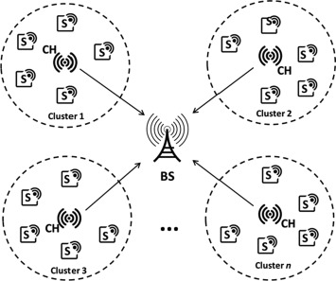
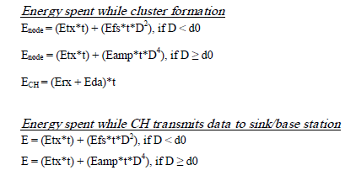
PARAMETERS & ENERGY UTILIZATION
Etx - Transmission energy from node to
Cluster head
Efs- Free space energy b/w nodes
Eamp - Amplification energy
Erx - Energy to receive information
Eda - Data aggregation energy
D = distance of CH to sink at (50, 50)
d0 = (Efs/Eamp)^{1/2}

Slide 12
RESULTS
TABLE - Network Lifetime Comparison
Approach | LEACH | GWBOC | Proposed
FND | 1499 | 1657 | 2532
HND | 1702 | 2309 | 2536
LND | 1964 | 3404 | 2551
With this proposed method, FND was improved by 68.91% and 52.8% compared to LEACH and GWBOC methods respectively.

Slide 13
RESULTS
FND Comparison
Number of dead nods at subsequent rounds

Slide 14
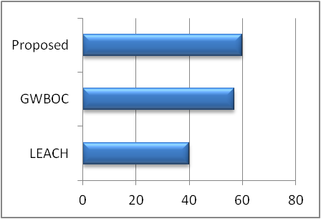
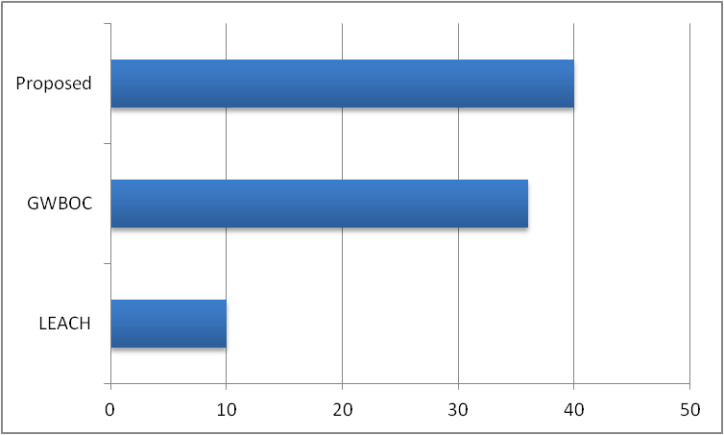
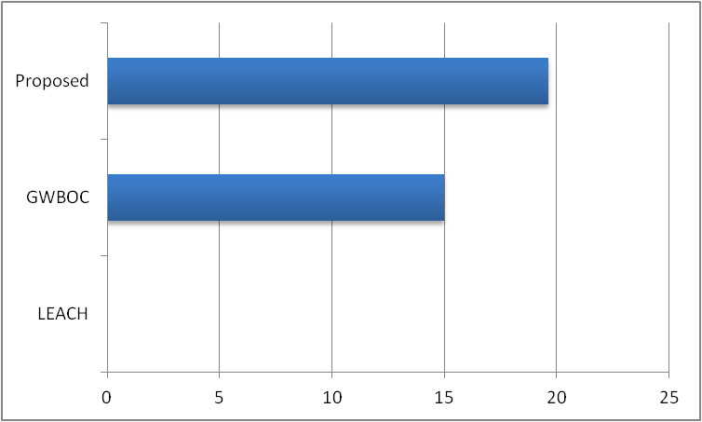
RESULTS
Energy left at :-
a) 1000 rounds b) 1500 rounds c) 2000 rounds

Slide 15
REFERENCES
1.FCA - An Approach On LEACH Protocol Of Wireless Sensor Networks Using Fuzzy Logic
2. Article in Science Publishing Group - Maximization Lifetime in Wireless Sensor Network by Fuzzy Logic for Cluster Head Selection
3. https://www.datasciencecentral.com/smart-cities-of-the-future-powered-by-iot/
4. Science Direct - cluster-based nodes in IoT sensor networks with periodic mode of operation

